Slide 1
Module 4 – No Net Loss / Net Gain
Training Modules for Applying the Mitigation Hierarchy:
Planning Policy and Projects for No Net Loss or a Net Gain of Biodiversity
Module 4
No Net Loss and Biodiversity Net Gain: meaning, what are the precedents, what is feasible, how to plan

Slide 2
No Net Loss and Biodiversity Net Gain Module – Abstract
This training course is about planning for Biodiversity Net Gain, No Net Loss (BNG/NNL) of biodiversity or some other conservation goal. This module explains these terms, and gives examples of governments’ policies around the world in this area.
A loss-gain assessment - at the landscape, regional or national level - helps predict biodiversity losses anticipated in the coming decades from development and the gains of biodiversity that could be achieved by broad-scale conservation.
The module explains how to undertake such an assessment, to establish whether BNG or NNL are reasonable conservation targets, or a conservation-target based approach (involving net loss) is more realistic.

Slide 3
No Net Loss and Biodiversity Net Gain Module – Contents
Contents | Slides
Introduction – meaning of No Net Loss and Biodiversity Net Gain | 4-5
No Net Loss and Biodiversity Net Gain – precedent in government policy | 6-7
Loss-Gain Assessment | 8-13
Take home messages | 14

Slide 4
Biodiversity Net Gain and No Net Loss: Meaning
Simply stated, Biodiversity Net Gain (BNG),
sometimes described as Net Positive Impact (NPI), means
leaving biodiversity better off following development activity,
compared with a clear reference scenario.
No Net Loss is similar – with impacts at least balanced by the mitigation measures.
For governments, the goal may be set at a national, regional or local level.
For companies, the goal may be at a site, project or corporate level, or for part of the value chain.
For financial institutions, the focus could be their investment strategies, based on environment, social and governance (ESG) policy that refers to BNG.
In all cases, the goal must be defined relative to an appropriate reference scenario:
‘Net Gain of what and compared with what?’
Notes:
No Net Loss (NNL)
A goal for a development project, policy, plan or activity in which the impacts on biodiversity it causes are balanced or outweighed by measures taken to avoid and minimise the impacts, to undertake on-site restoration and finally to offset the residual impacts, so that no overall loss remains.
Biodiversity Net Gain (BNG)
A goal for a development project, policy, plan or activity in which the impacts on biodiversity it causes are outweighed by measures taken to avoid and minimise the impacts, to undertake on-site restoration and finally to offset the residual impacts, to the extent that the gain exceeds the loss.
NNL and BNG must be defined relative to an appropriate reference scenario (‘NNL or net gain of what compared with what?’). For governments, this goal may be set at a national, regional or local level. For companies, the goal may be at a site, project or corporate level, or for part of the value chain. For financial institutions, the focus could be their investment strategies, based on environment, social and governance (ESG) policy that refers to BNG/NNL.

Slide 5
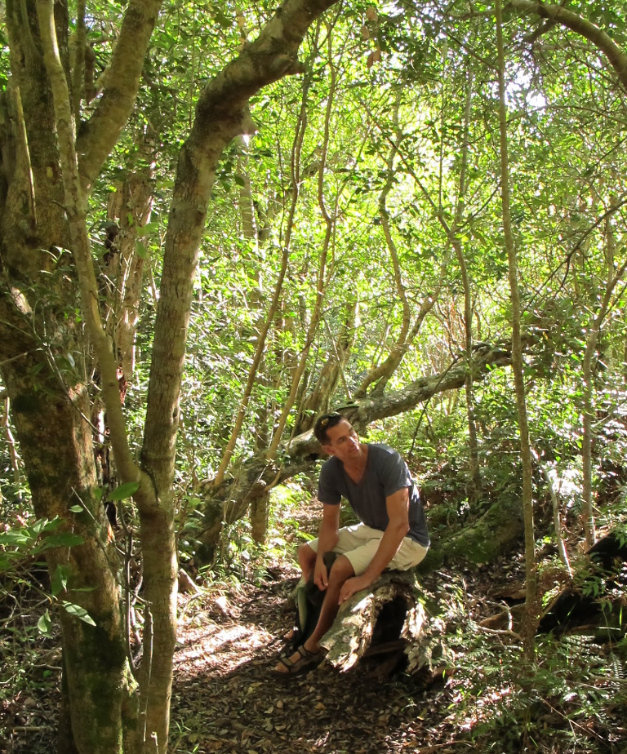
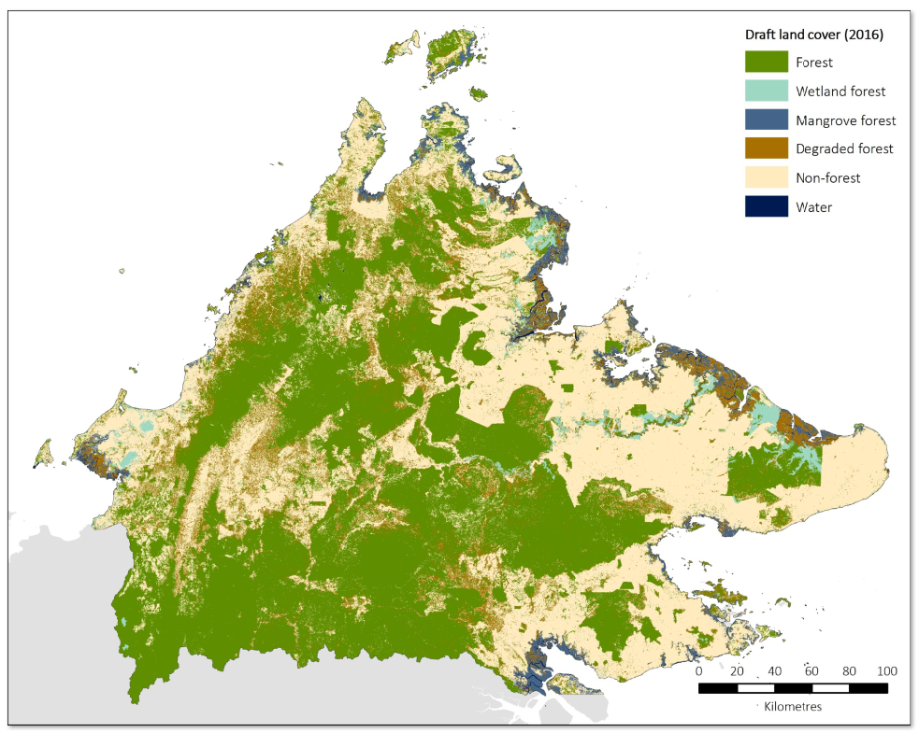
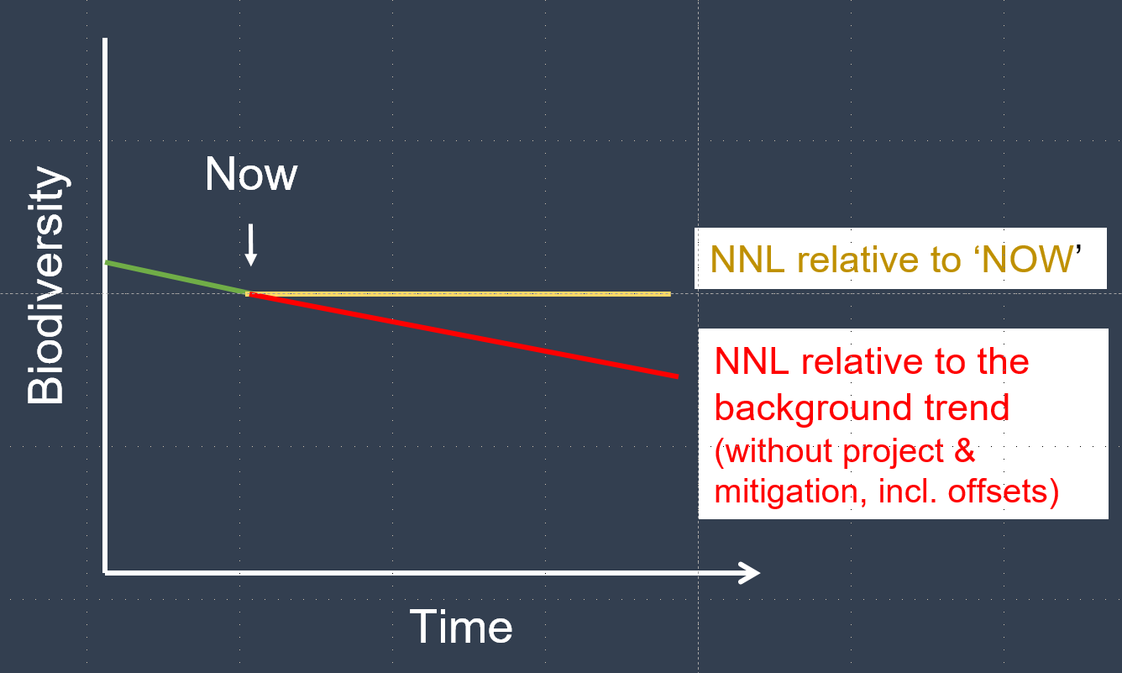
Biodiversity Net Gain and No Net Loss: Meaning
For any policy or project planning for NG or NNL, there are two central questions:
NNL / Net Gain of what?
2. NNL/ Net Gain relative to what?
An outcomes-based target (set at some desirable level for specific biota) could provide this static reference level! It doesn’t need to be relative to ‘now’ but could be a target. See target-based compensation.
→ Linked to this is the question: What is a desirable level for biodiversity?
Notes:
The first big question to resolve is NG of what? The second question is NG relative to what? What is the baseline? One needs to use a defensible frame of reference of what would happen without development and associated offsets (i.e. a trajectory of change over time into account, possibly a biodiversity decline, as shown by the red line in our graph here.).

Slide 6
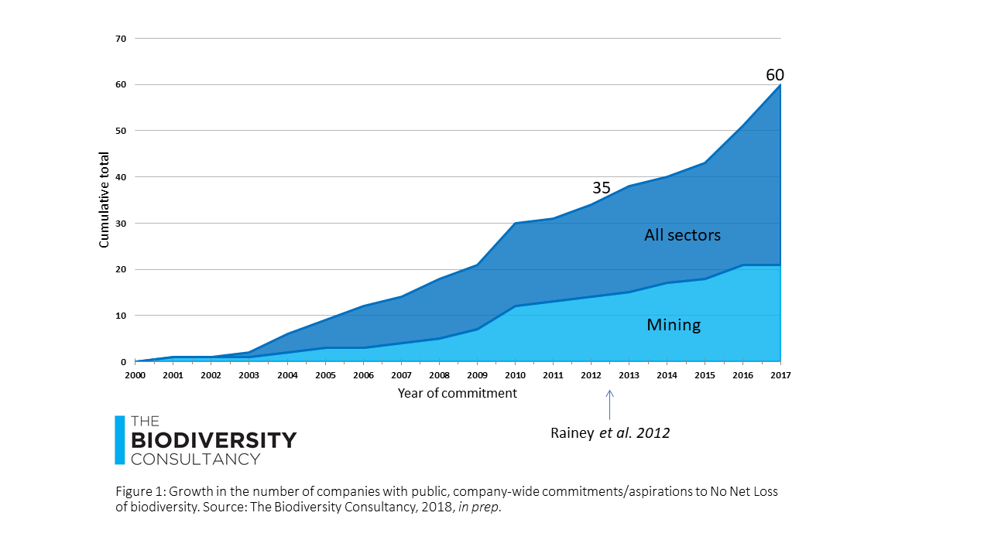
No Net Loss and Biodiversity Net Gain: precedent
Governments: Law or policy on No Net Loss or a Net Gain of biodiversity, biodiversity offsets or compensation in over 100 countries.
Companies:
60+ companies with public, company-wide commitments or stated aspirations related to No Net Loss or Net Gain of biodiversity.
Board of The Consumer Goods Forum (CEOs of 50 companies - mainly manufacturing and retail), pledged to mobilise resources within their businesses to help achieve zero net deforestation by 2020.
Financial institutions:
IFC’s PS6 on ‘Conservation and Sustainable Management of Living Natural Resources’ requires clients to ensure Biodiversity Net Gain for impacts on critical habitat and, where feasible, No Net Loss for impacts on natural habitat.
IFC Standards now adopted by the 96 financial institutions in 37 countries
Similar provisions are now found in financial institutions’ safeguard policies, such as the World Bank’s Environmental and Social Safeguards.
International organisations: 2016, IUCN policy on biodiversity offsets.
Notes:
xiv The Biodiversity Consultancy, 2018
xv Consumer Goods Forum, 2010

Slide 7
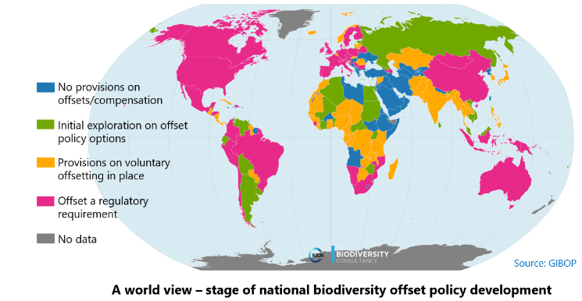
NNL/BNG: precedent in government policy
2014:
2018:
39 countries had existing laws or policies on No Net Loss or a Net Gain of biodiversity, biodiversity offsets or compensation and 22 were developing them.
74-100 countries now have them (depending on the breadth or precision of the scope of policy considered).
GIBOP is run by IUCN, TBC, DICE
Notes:
ten Kate and Crowe, 2014 (2014 govt figs) ten Kate, K. and Crowe, M.L.A. 2014. Biodiversity Offsets: Policy options for governments. An input paper for the IUCN Technical Study Group on Biodiversity Offsets. Gland, Switzerland: IUCN. 91pp.
Maron et al, 2016; IUCN and The Biodiversity Consultancy, 2017
Maron, Martine, Christopher D. Ives, Heini Kujala, Joseph W. Bull, Fleur J. F. Maseyk, Sarah Bekessy, Ascelin Gordon, James E.M. Watson, Pia E. Lentini, Philip Gibbons, Hugh P. Possingham, Richard J. Hobbs, David A. Keith, Brendan A. Wintle, Megan C. Evans; Taming a Wicked Problem: Resolving Controversies in Biodiversity Offsetting, BioScience, Volume 66, Issue 6, 1 June 2016, Pages 489–498.
https://portals.iucn.org/offsetpolicy/

Slide 8
Establishing NNL/BNG
Loss-Gain Assessment

Slide 9
No Net Loss and Biodiversity Net Gain
⇒ See the module on Key Concepts for discussion of baselines and ‘No Net Loss of what relative to what?’

Slide 10
No Net Loss and Biodiversity Net Gain: What’s feasible? A Loss-Gain Analysis
The objective of a Loss-Gain analysis (LGA) is to gauge the feasibility of a country or state achieving NNL or Biodiversity Net Gain (given the existing conservation policy and planned development trajectory). If the assessment shows that a BNG trajectory is currently not feasible, an alternative policy goal such as ‘Managed Retention’/ ‘Managed Net Loss’ may be preferable.
The LGA develops an understanding of the likely biodiversity losses and gains associated with potential land-use changes under different policy relevant scenarios and informs sound decisions about the feasibility and scope of a NG Policy for the country/state.
The LGA uses the best available data to produce key spatial layers and other information to define a plausible, adequately detailed land use change scenario to illustrate potential losses and gains across the area under study (country, region). This involves choosing a suitable timeframe for the analysis, selecting a biodiversity proxy and provisional metrics, investigating and modelling patterns of land use change, and establishing a defensible reference scenario as well as the underlying rules for assessing biodiversity losses and gains under a given scenario.
Notes:
Simply stated, Biodiversity Net Gain (BNG), also sometimes described as Net Positive Impact (NPI), means leaving biodiversity better off following development activity, compared with a clear reference scenario

Slide 11
Approach to a L/G Analysis
Set out framework for analysis
Define scale, timeframe, scope, etc.
Consider policy options (scope and ambition: NG rel. to?)
Collect and produce good data layers
Do analysis and build scenarios to inform decision-making:
Establish trend against which to compare loss and gain
Include avoidance of impacts
Project losses and offset requirements
Estimate potential gains – e.g. through averted loss and restoration.
Review feasibility of NNL/NG under given scenario
Investigate potential changes/ an alternative approach (e.g. framed around targets/ thresholds).
Make recommendations for policy

Slide 12
Loss-Gain Assessment: Key steps
Assemble biodiversity and land use information and spatially explicit data for the analysis and organize in an information system. Note gaps and limitations.
Identify study area, frame of reference and desired outcome (timeframe, scale/ extent, reference scenario: target of the desired outcome for biodiversity or counterfactual, limits etc.)
Define policy scenario/s to inform the land use change analysis. Distinguish between activities and effects that would be considered ‘scheduled’ (i.e. subject to the mitigation policy) and those that would be exempt from the policy
Develop proxies and metrics to represent and quantify the extent and quality of chosen biodiversity component across the study area. Establish exchange rules for losses and gains.
Establish land cover/use change scenario/s across the study area under a chosen policy scenario and scope, a) for a starting point (current situation) and b) by projecting likely future land cover/use patterns.
Estimate potential losses due to changes between land cover and use classes. Ensure that biodiversity / areas where impacts should be avoided under existing legislation are ‘masked out’ (may not be converted).
Develop additionality requirements and gain rules. Assess the potential for achieving gains across the study area to counterbalance predicted losses in biodiversity.
Assess the extent to which NNL or a NG can be achieved under a given scenario and what changes – if any – would be needed to enable achievement of this goal.
Notes:
Assemble relevant, readily available biodiversity and land use information and spatially explicit data required for the analysis and note significant data gaps and limitations.
Organise data in an interim information system.
Define a frame of reference (timeframe, scale, conceptual biophysical reference scenario/ counterfactual, etc.)
Define policy scenario/s to inform the land use change analysis and establish the main policy focus of this policy (e.g. different types of forest or other terrestrial and aquatic systems, or specific species)
Develop proxies and provisional metrics to represent and quantify the extent and quality of the chosen biodiversity component across the study area, and establish provisional exchange rules for losses and gains.
Produce additional input layers, drawing on existing data, where feasible and necessary.
For the chosen timeframe, establish land cover/use patterns across the study area, a) for a starting point (current situation) and b) by projecting likely future land cover/use patterns. Arrange land use/ cover changes according to a chosen policy scenario and scope. Distinguish between activities and effects that would be considered ‘scheduled’ (i.e. subject to a NG policy) and those that would be exempt from the policy, thus forming part of a background rate of change.
Describe the resulting land use change scenario/s, based on predicted changes between current and future land cover and use patterns, and set out an explicit and plausible reference scenario for the given timeframe.
Estimate potential losses resulting from the changes between the different land cover and use classes.
Develop provisional additionality requirements and gain rules and assess the potential for achieving gains across the study area to counterbalance predicted losses in biodiversity
Assess the extent to which a NG can be achieved for a given state-wide land cover/use change scenario and provisional exchange rules. Examine the influence of reasonable variations to the rules and offer preliminary conclusions on the feasibility the nature, amount and location of any additional conservation activities that may be needed to achieve NG.

Slide 13
Loss-Gain Analysis: About data
Data for the LGA are needed to inform the selection of appropriate biodiversity proxies, conservation significance, application of the mitigation hierarchy, metrics and exchange rules (e.g. ‘like-for-like or better’ approach) for comparing losses and gains, to establish a plausible reference scenario/s and simulate land use change scenarios.
Plausible reference scenario: needed to answer what ‘net’ refers to by answering the question: ‘No Net Loss or Net Gain compared with what?’. Options include:
Static, e.g. compared to a desired state of biodiversity (measurable target) OR the state of biodiversity ‘now’
Dynamic, compared to trajectory without scheduled impacts and offsets (counterfactual reference scenario)
Biodiversity proxy: For a national or regional loss-gain assessment, some proxy of biodiversity will be needed (as it is impossible to assess every component of biodiversity), for example forest types. Extent and change in extent can usually be determined using high quality land cover layer (derived from remote sensing images). Limitations to using e.g. forest cover (extent only) as a proxy for overall biodiversity can be partially addressed by additional measures of forest condition.
Metrics and exchange rules: Fundamental for a L/G analysis and setting up a NG system are appropriate metrics (to quantify losses and gains) and exchange rules (to ensure equivalence).

Slide 14
No Net Loss and Biodiversity Net Gain Module –
Take home messages
Following the mitigation hierarchy can help governments and companies to reconcile development and biodiversity conservation goals.
Around 100 countries, 97 banks and many companies have commitments to No Net Loss, Biodiversity Net Gain or some other conservation goal.
Simply stated, Biodiversity Net Gain (BNG) means leaving biodiversity better off following development activity, compared with a clear reference scenario.
When considering policy options, and in order to plan for NNL/NG, particularly at the landscape, regional or national level, it helps to understand how the policy would align with overarching biodiversity targets so that compensation policy can be designed contribute to meeting these.
It is also important to assess biodiversity losses likely to arise from planned development as well as the gains of biodiversity that could feasibly be achieved through compensatory conservation, in order to establish whether NNL/NG are not only desirable but also reasonable policy goals, or whether Managed Net Loss is more realistic and also defensible in the context of biodiversity targets.
A Loss-Gain Assessment, based on appropriate data, explicit assumptions, relevant policy options and land use change scenarios, is advisable to support defensible and realistic policy choices.

